Slide 1


Preliminary Design of a Cube Satellite Compliant Hall Thruster
Alexis M. F. Hepburn, Embry-Riddle Aeronautical University
April 18, 2020

Slide 2

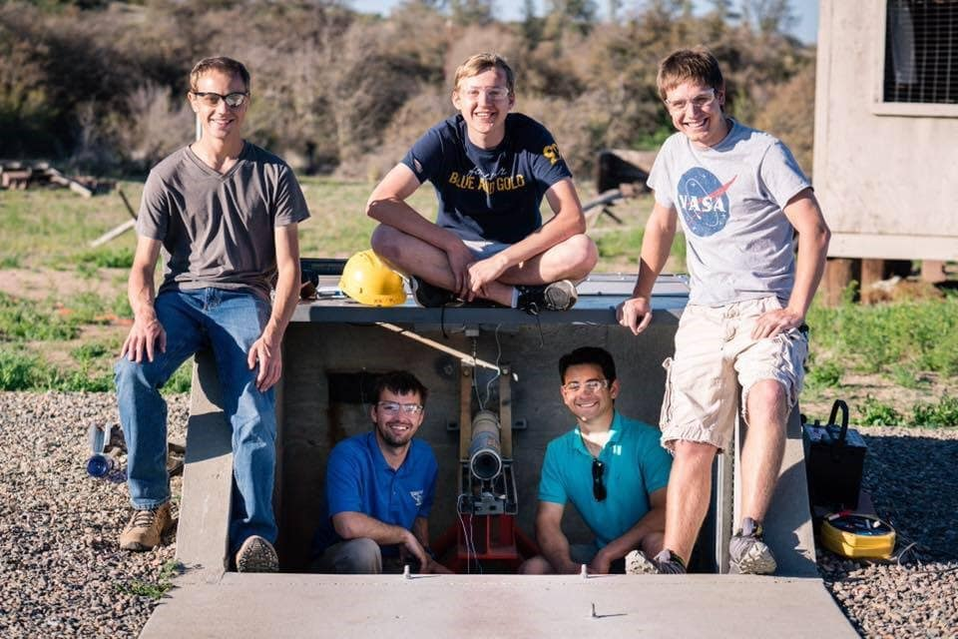
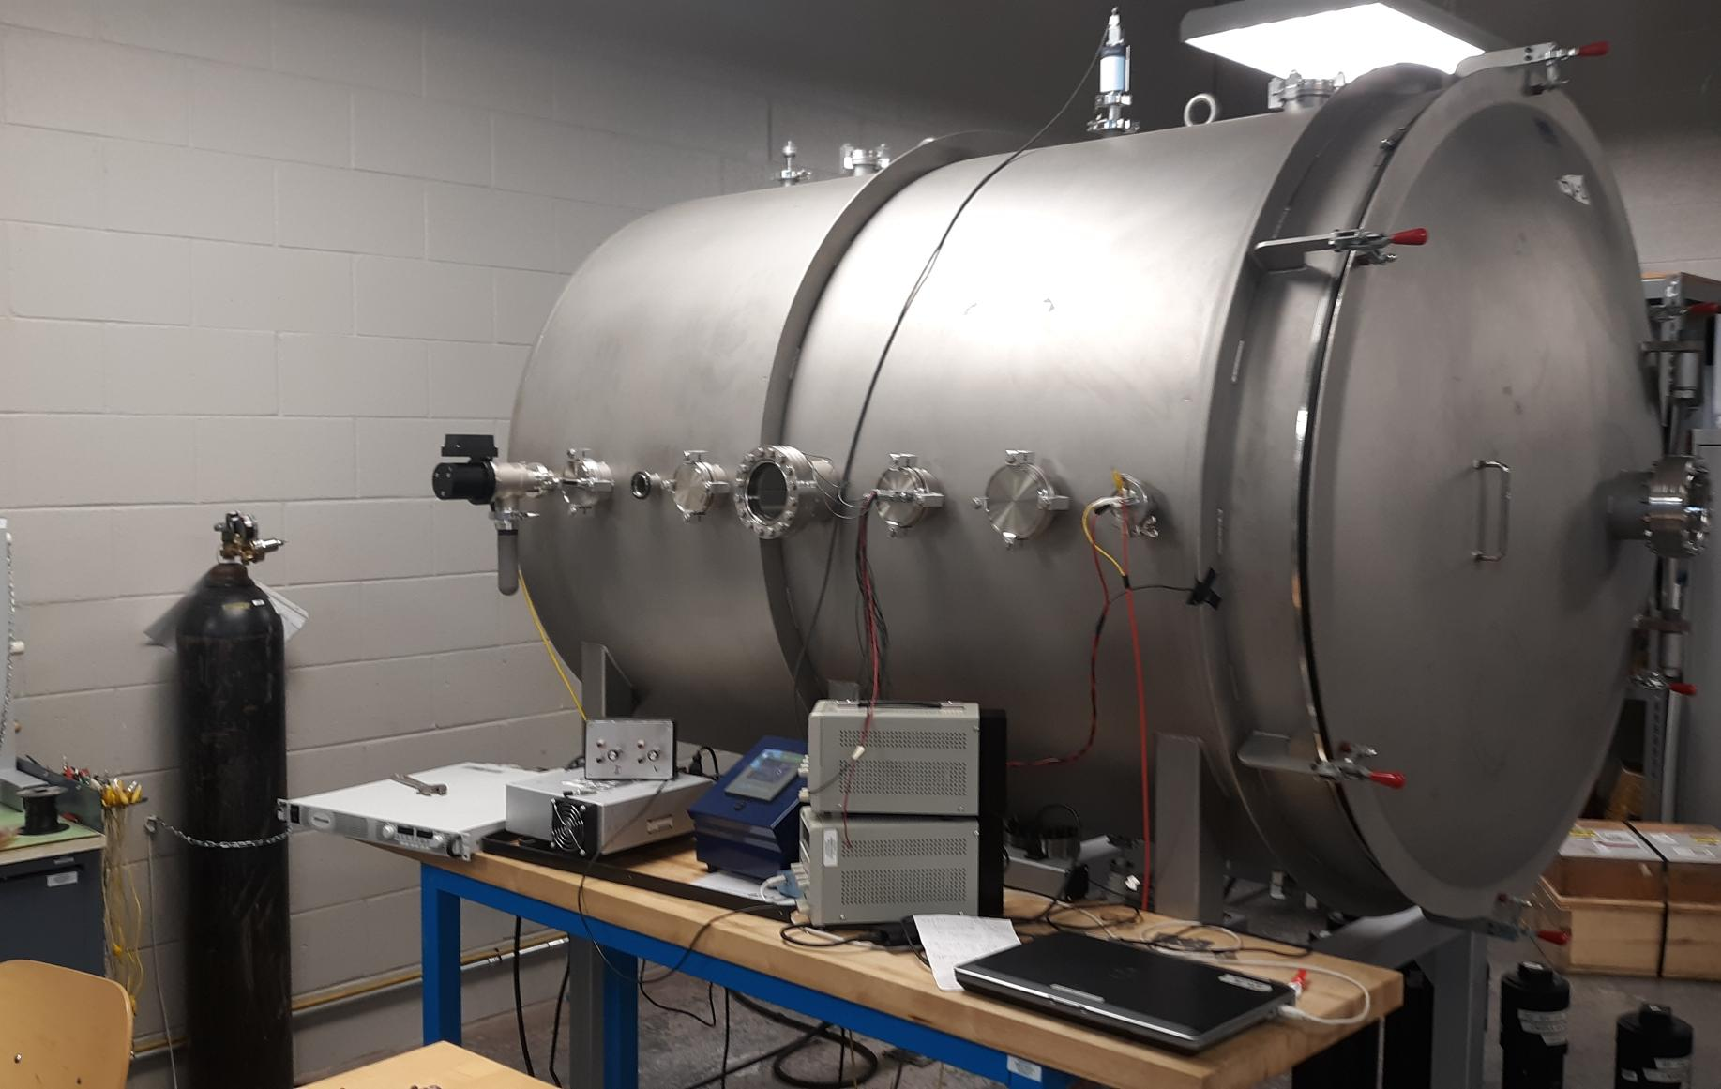
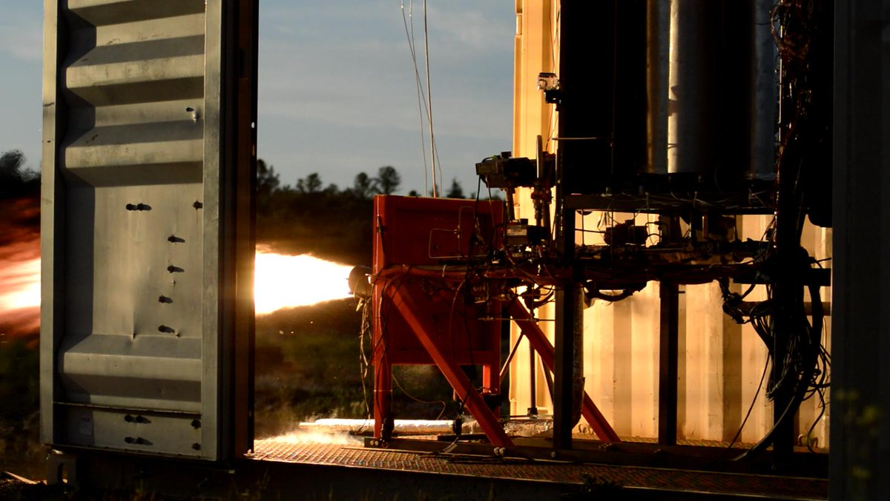
ERAU Propulsion Efforts
Liquid Rocket Engine Testing
Solid Rocket Motor Testing
Electric Thruster Testing

Slide 3
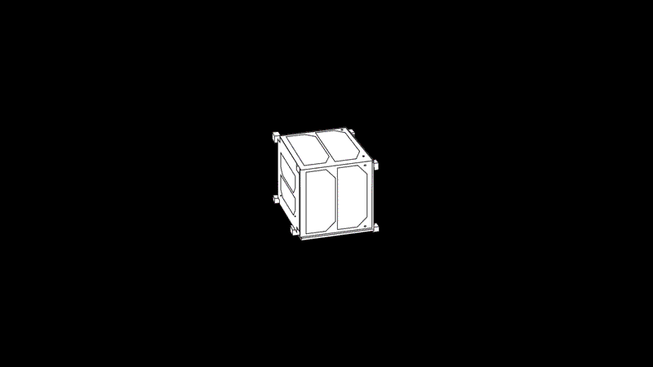
CubeSat History
History
  Started by CalPoly and Stanford in 1999
  Over 1,000 launched as of Jan. 2019
Applications
  Earth observation
  Amateur radio
  Flight V&V for new hardware
  Academic institution research

Slide 4
AGENDA
CubeSat Requirements
Size (per unit)
  Volume: 1,000 cm³
  Mass:1.3 kg
Propulsion
  Non-volatile propellants
  No pyrotechnics
  No high-pressure working fluids
Parameter | Complication
Thruster Efficiency | Poor propellant utilization due to broad distribution of ion exit velocities
Thruster Lifetime | Historically higher channel erosion rates
Thermal Management | Heat transfer by radiation is poor, increasing steady state temperature

Slide 5
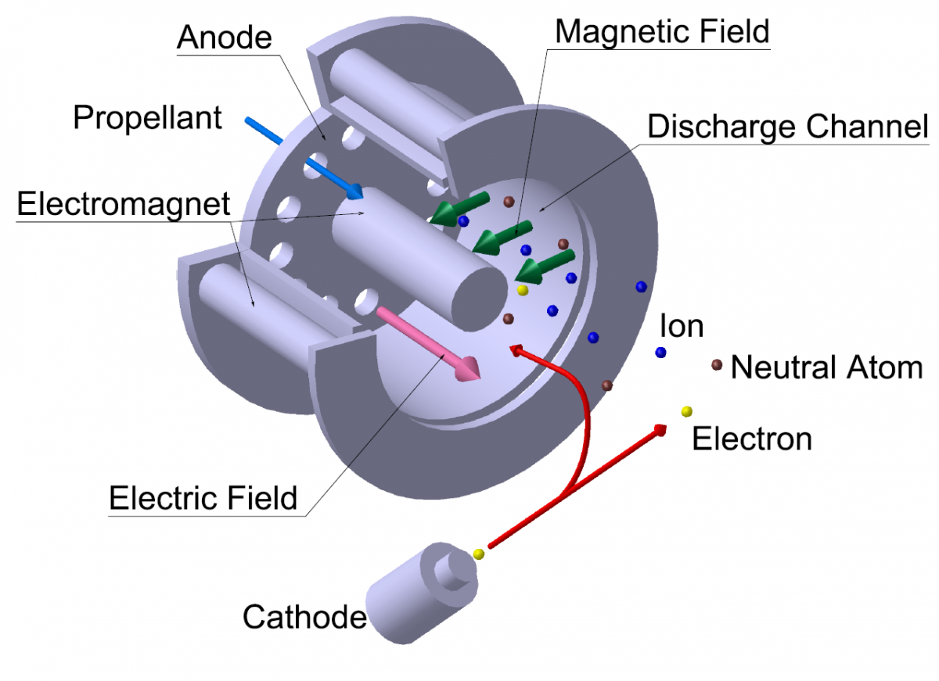
Hall Thrusters
Electrostatic System
  Electric field accelerates
  Magnetic field condenses
Common Propellants
  Xenon
  Argon
Figure 1: Hall Thruster [1]
Notes:
https://uzay.tubitak.gov.tr/en/uydu-uzay/hale

Slide 6
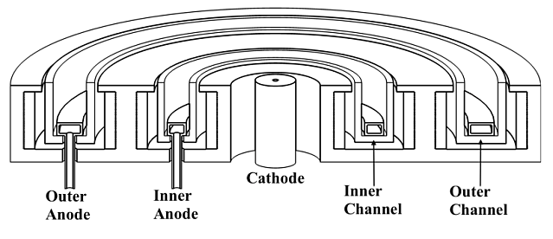
SPT-Type
Insulator
Conductor
Notes:
https://beyondnerva.com/electric-propulsion/hall-effect-thrusters/

Slide 7
Research Objectives
Develop a CubeSat compliant SPT HET
  Based on Russian OKB Fakel SPT-100
  Utilizing conventional electromagnetism physics
Mission
Parameter | Translation | Goal Value
Delta-V | Energy to move vehicle | 2 km/s
Firing Time | Engine operating time | 1,000 – 2,000 hrs
Propellant Throughput | Fuel consumed | 2 – 2.5 kg
Isp | Fuel efficiency | 1,250 s

Slide 8
Research Benefits
ERAU
  First EP attempt
  New safety procedures
  Hardware for future projects
  Representation in a new industry
Industry/Academia
  Exploration of vaporized metals
  Development of cube satellite compliant propulsion
  Open source designs and artifacts
Element | Molecular Weight (AMU) | Cost (USD/kg) | Melting Point (°C) | Ionization Energy (kJ/mol) | Reactivity
Magnesium | 24 | 37 | 650 | 738 | Moderate
Zinc | 65 | 53 | 420 | 906 | Low
Bismuth | 209 | 39 | 271 | 703 | Low
Mercury | 201 | 48 | -39 | 1007 | Low
Lead | 207 | 23 | 327 | 716 | Low

Slide 9
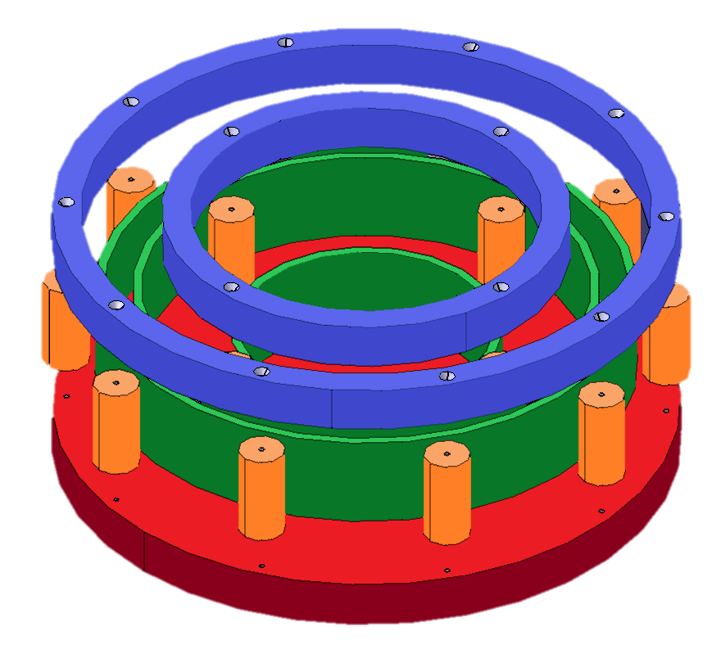
AGENDA
Thruster Design
Materials
  A36 Steel
  Alumina Silicate
  Stainless Steel
  SEM Cathode
Manufacturability
  Single plate thicknesses
  Single screw size
  Machined in house
Cost to Date
  Engine: $815 (w/ redundancies)
  Permanent hardware: $650
0.5 In.
3.3 In.
Figure 4: Current ERAU Hall Thruster Model

Slide 10
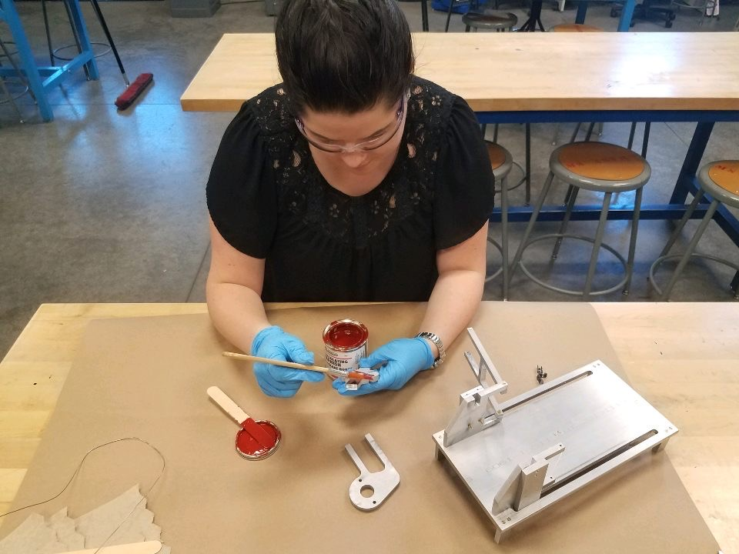
AGENDA
Test Article Preparation
Machining
  All components were machined
  deburred
Insulating
  Every metallic component was insulated with electrical and thermal insulation varnish
Electrical Continuity Tests
  Each electrical connection was verified after each step to ensure continuity

Slide 11
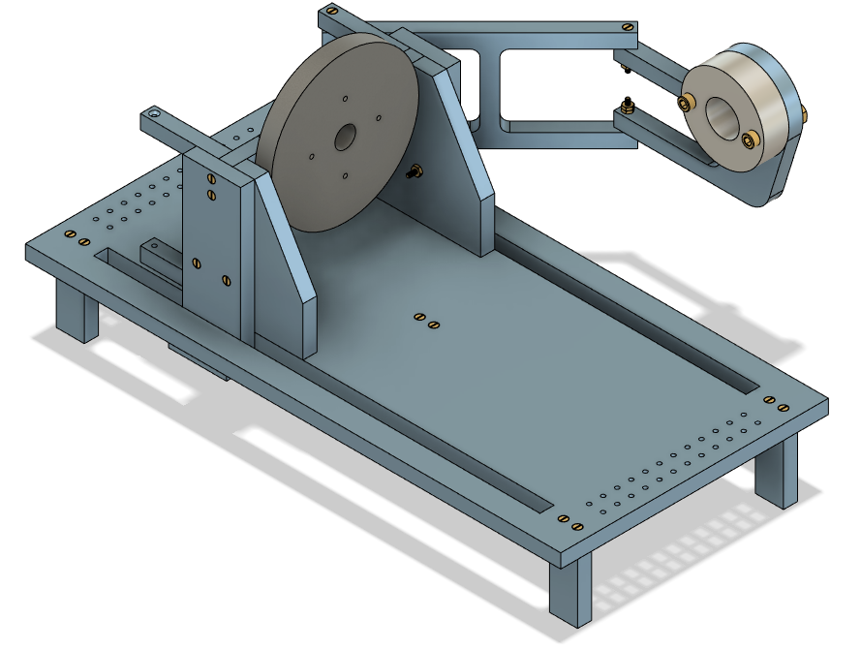
AGENDA
Test Stand
Cathode Mount
Variable distance and angle of intersection to plasma discharge
Thruster Integration Plate
Removeable thruster integration plate permits construction separate of the test stand
Grounded legs
Thruster remains an independent electrical circuit
Sliding Channels
Test article can be moved closer and farther from test instruments
Data Acquisition Attach Points
Modular holes for integration of test equipment

Slide 12
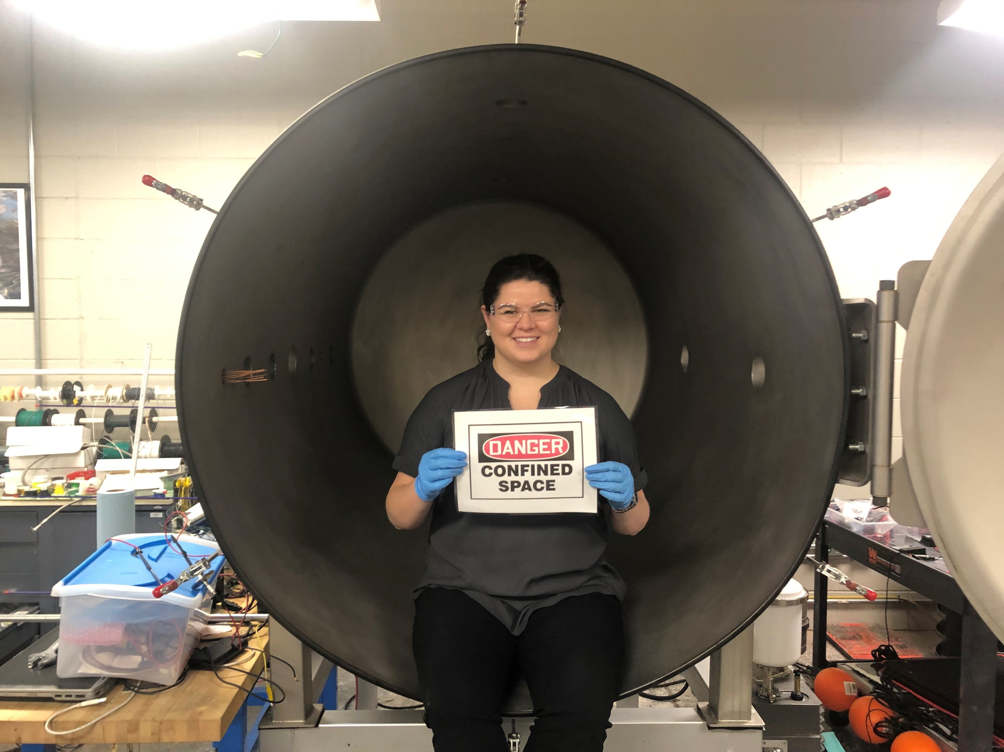
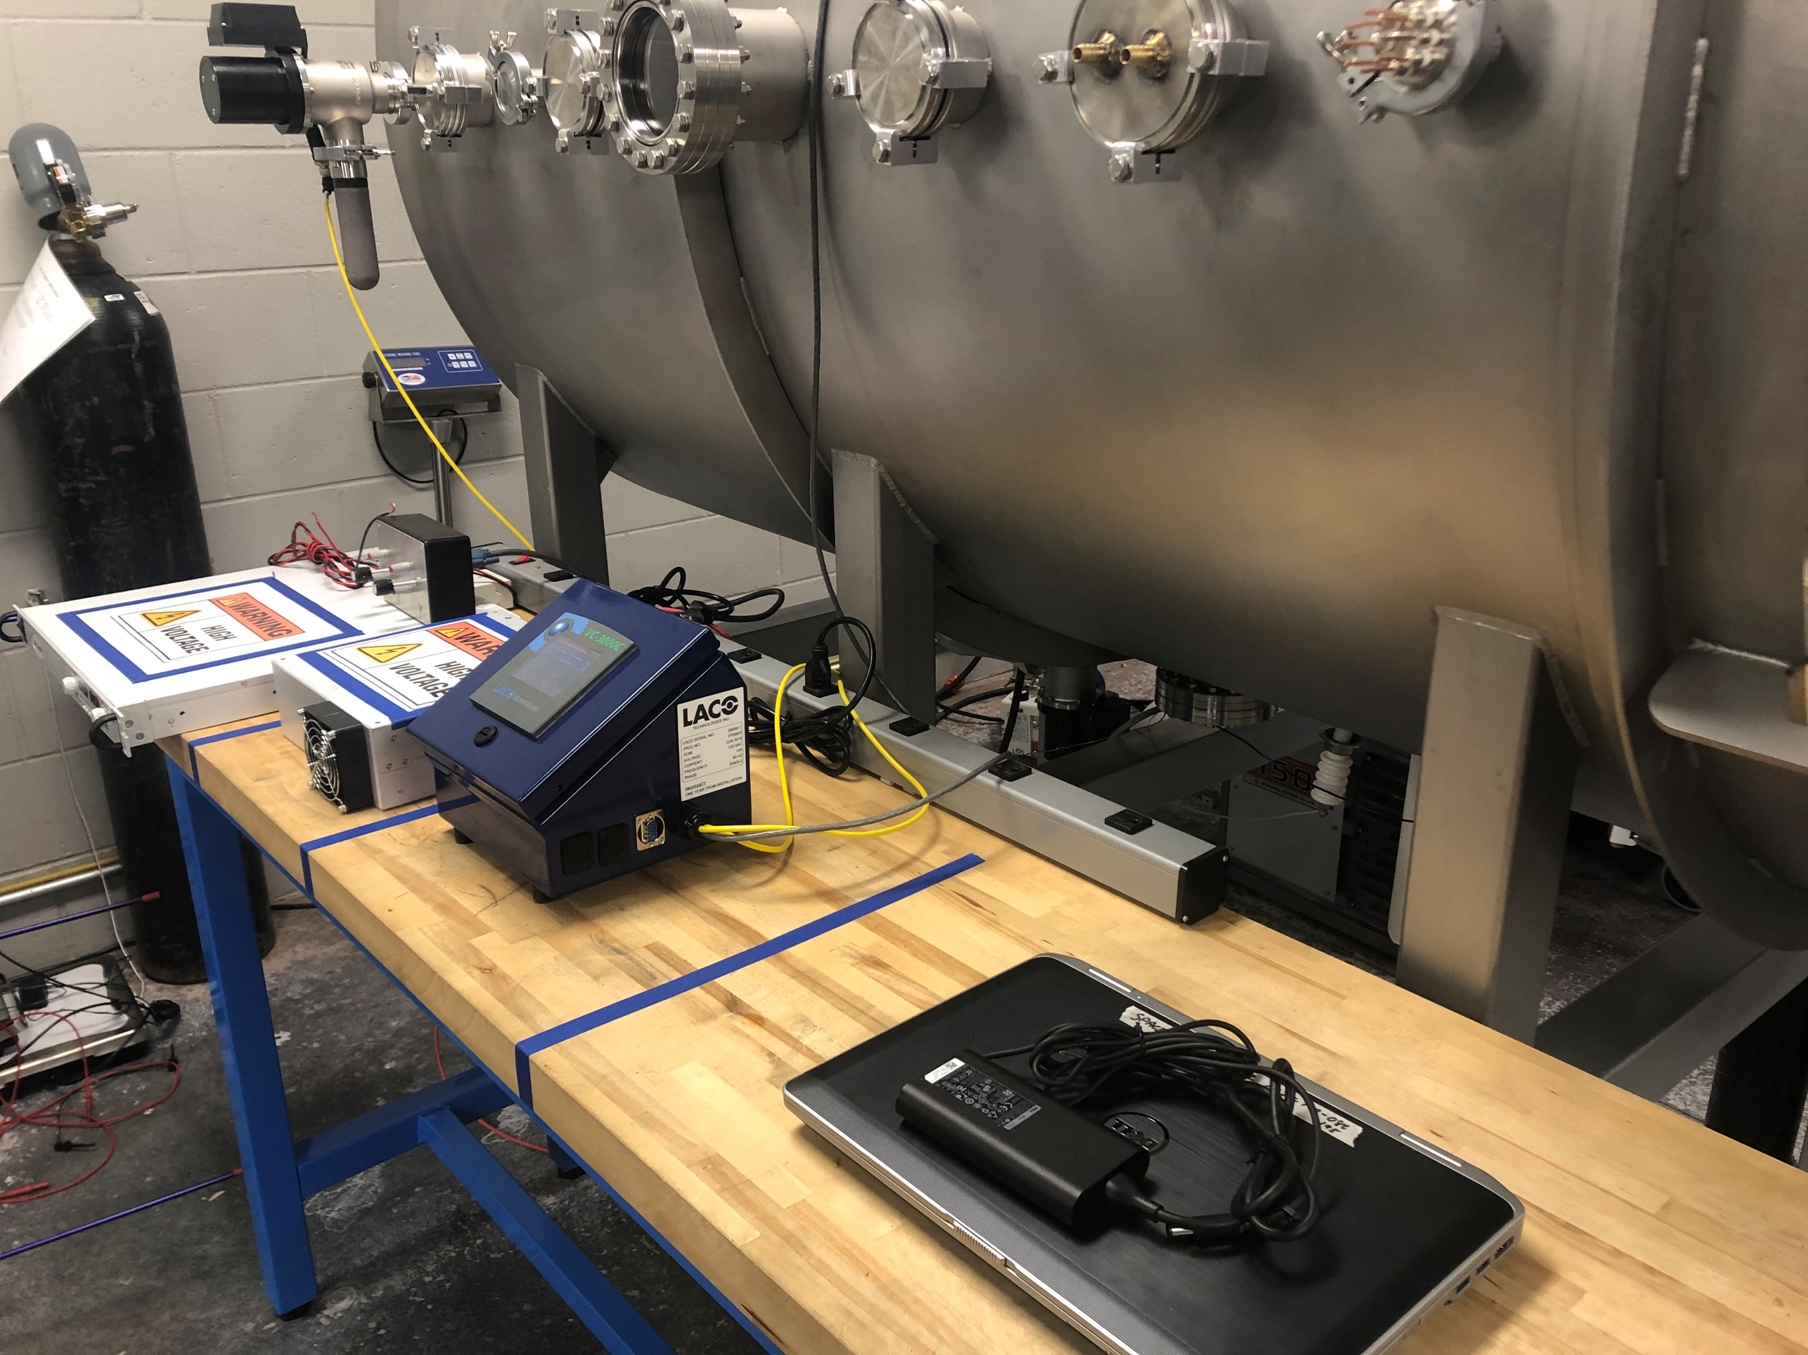
AGENDA
Vacuum Chamber Preparation
BEFORE
AFTER

Slide 13
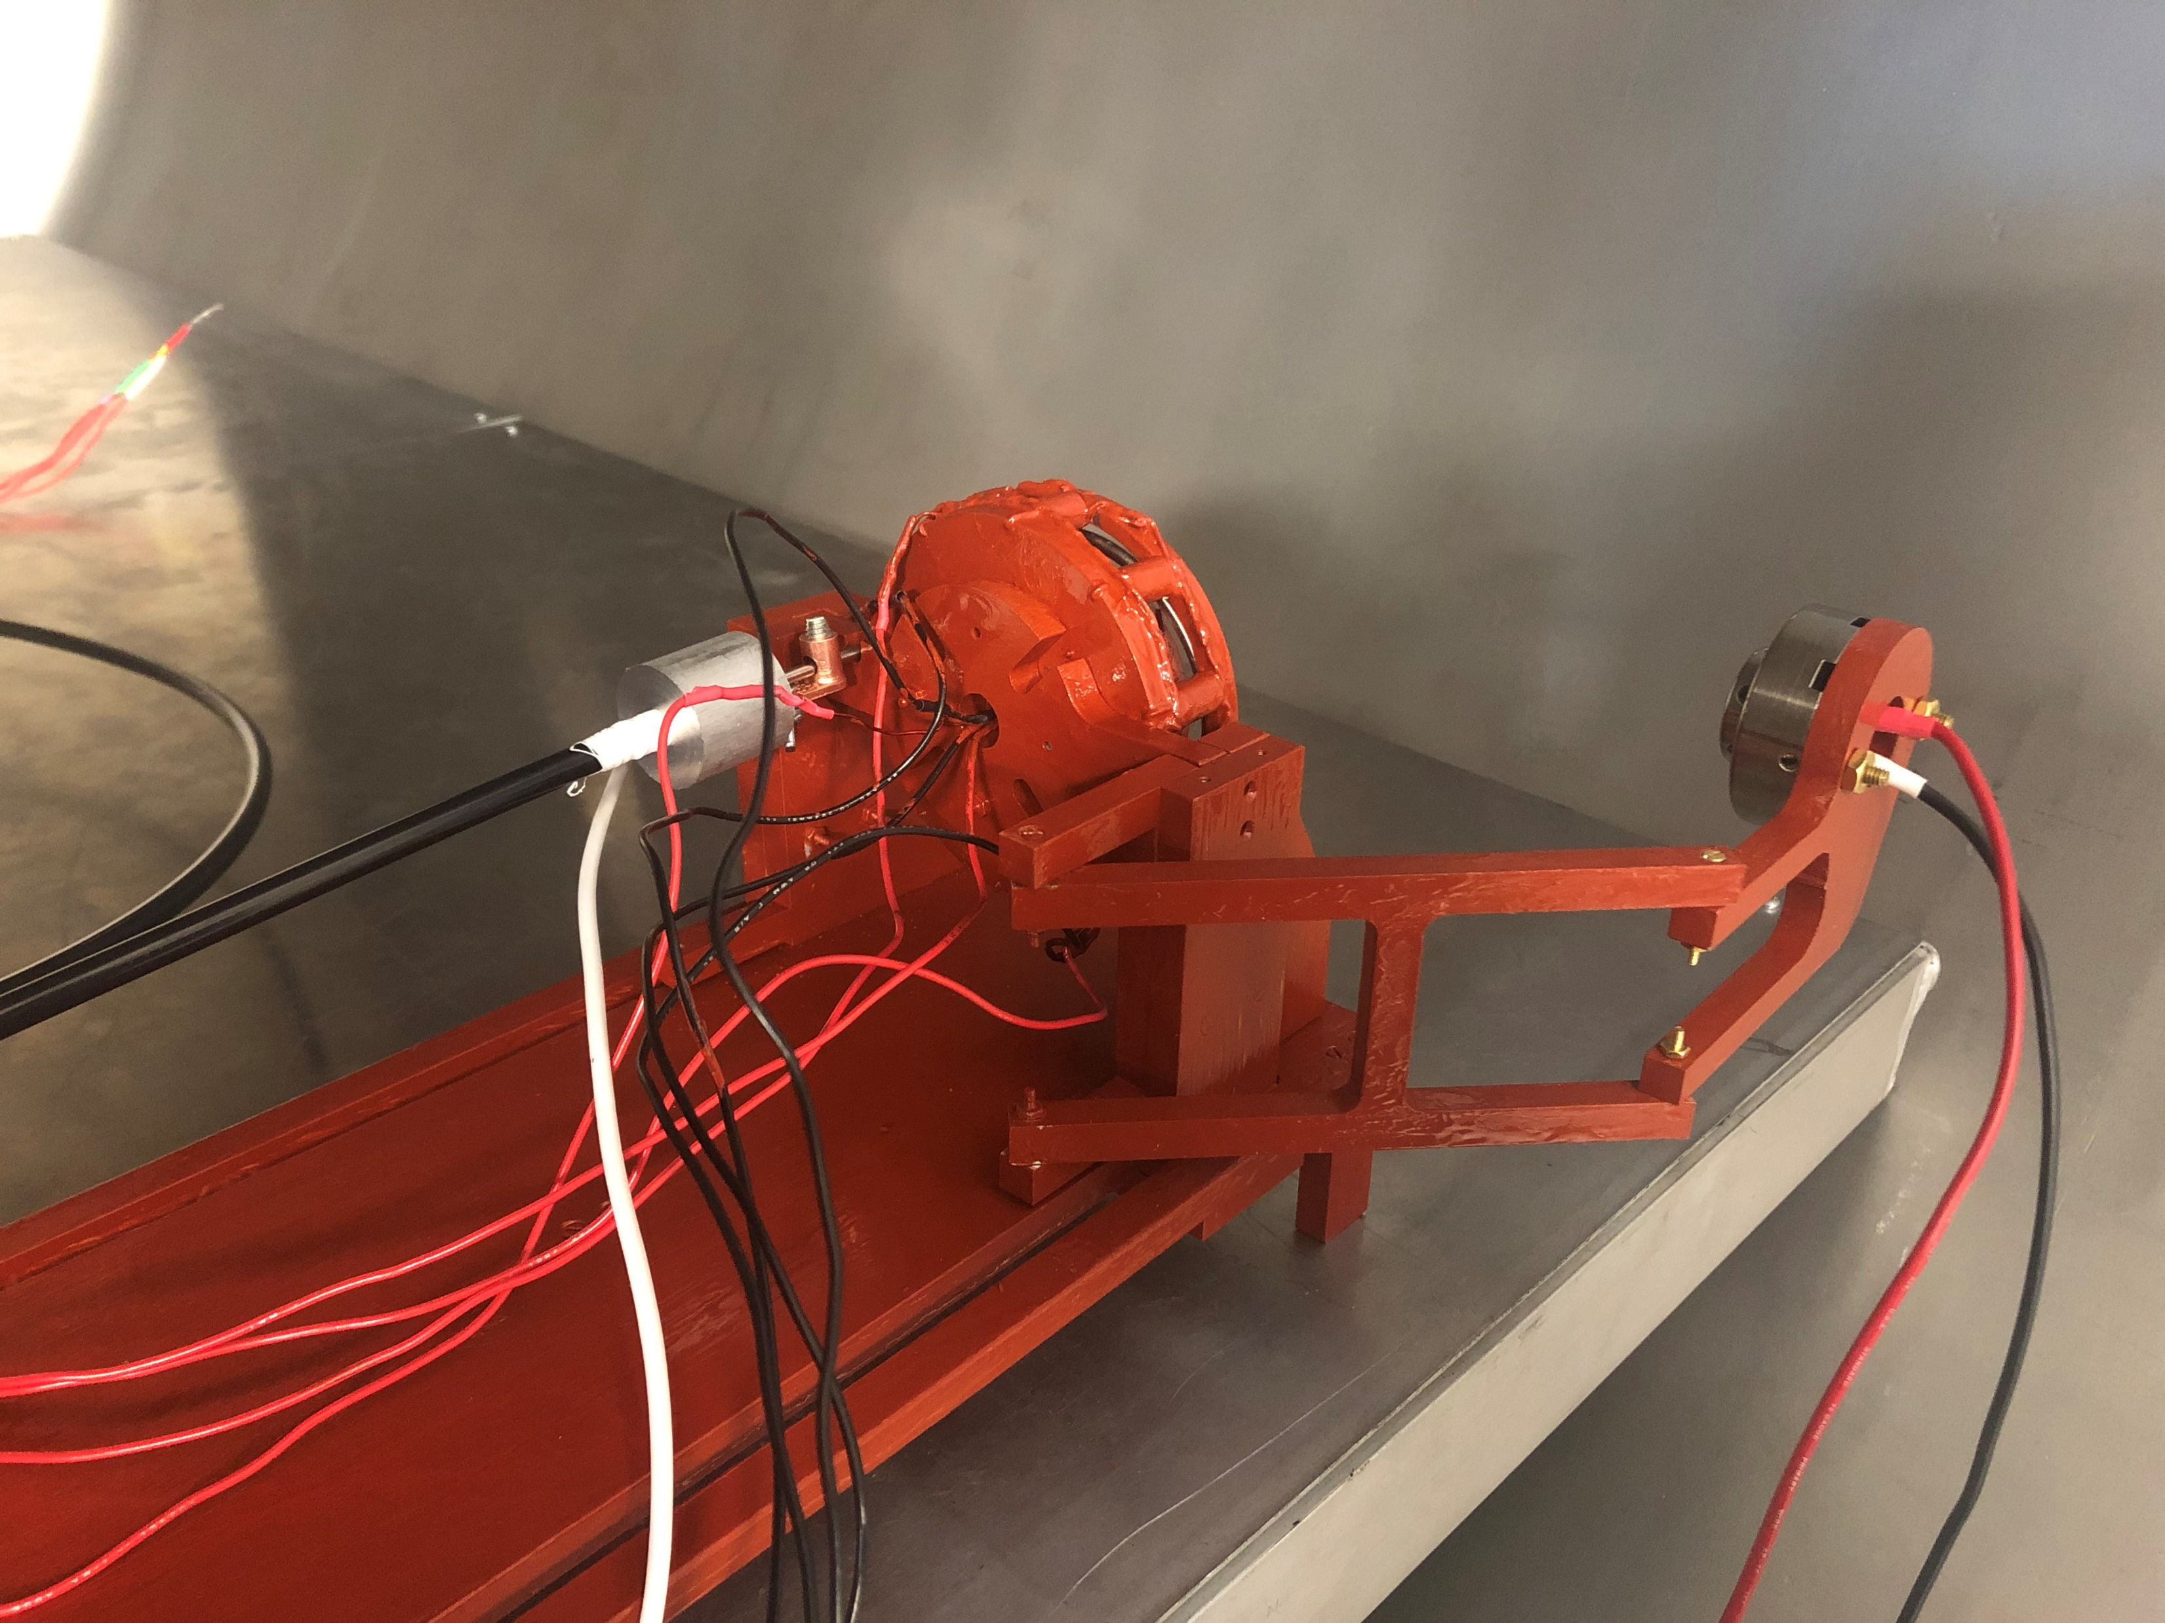
AGENDA
Testing Integration
Anode System
Thruster
1/8”stainless steel tubing to 1/4” tubing with Teflon tape and ground wire
Mounted to a modular integration plate that can be removed from the thrust stand
Solenoid Electrical Connections
Cathode Electrical Connections
Inner and outer solenoids wired separately in four complete series circuits
Independent power source limits risk of damaging connections or overheating LaB₆ crystal

Slide 14
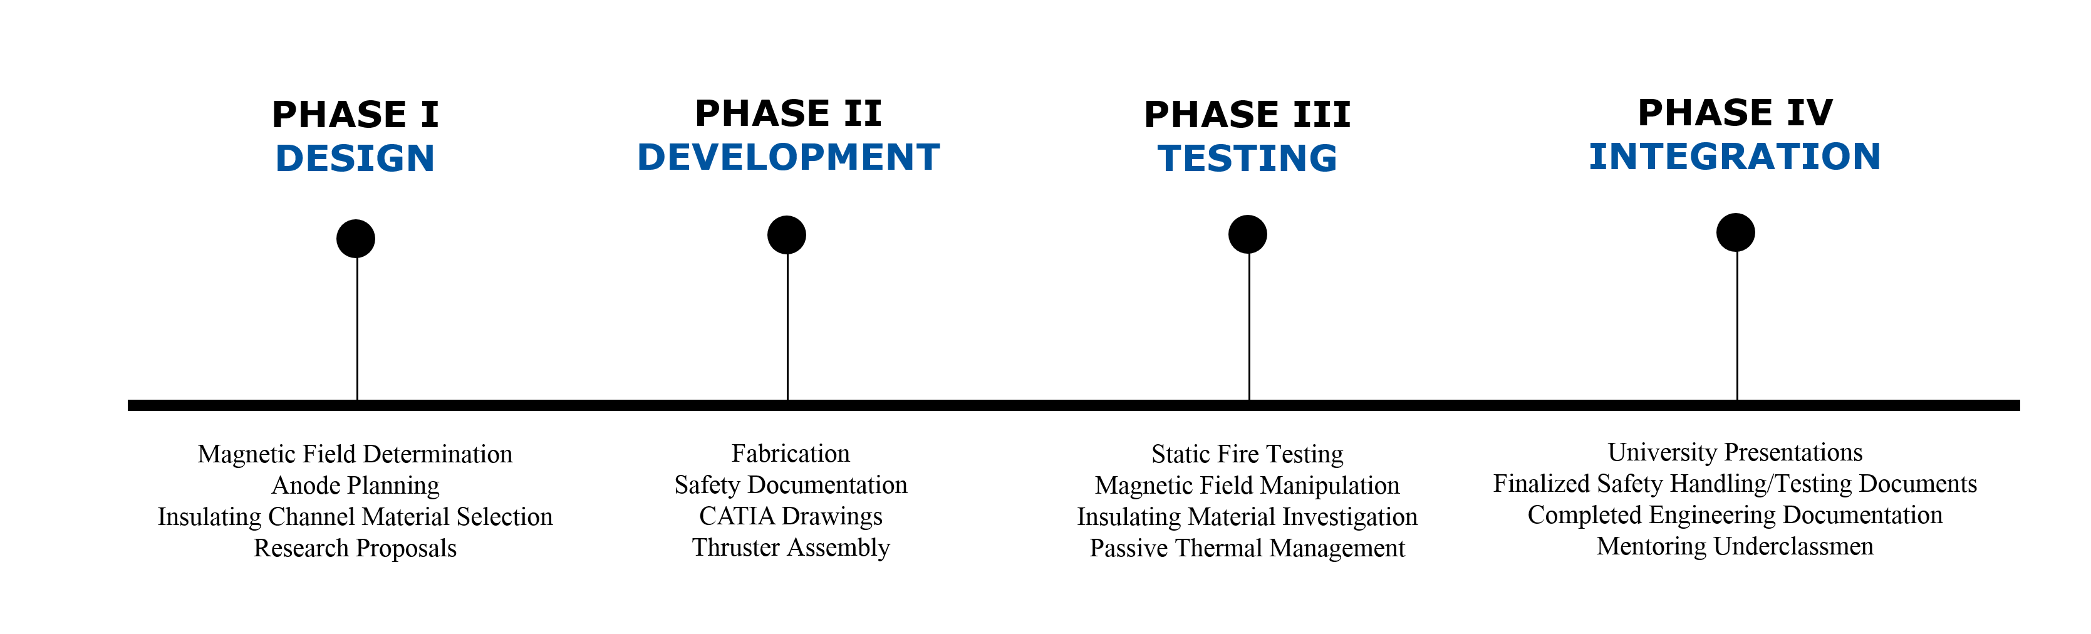
AGENDA
Current Timeline

Slide 15



AGENDA
Thank You
  Dr. Anne Boettcher
  Dr. Daniel White
  Dr. Elliot Bryner
  Nicholas Dyrland
  Corey Bullens
  ERAU Hazy Library Research Librarians
  ERAU Machining Staff & Assistants
  ERAU College of Engineering

Slide 16
AGENDA
Questions?
Alexis M. F. Hepburn
  Aerospace Engineering, Senior – Undergraduate
  Embry-Riddle Aeronautical University – Prescott, AZ
  NASA AZ Space Grant Undergraduate Research Consortium Intern
  NCHC Portz Interdisciplinary Research Fellow
  ERAU Undergraduate Research Institute Ignite Grant Recipient
  Linkedin.com/Alexis-Hepburn
  Hepbura1@my.erau.edu

Slide 17
AGENDA
Propellant Selection
 | Molecular Weight (AMU) | Cost ($/kg) | Melting Point (°C) | Ionization Energy (kJ/mol) | Reactivity | Toxicity
Magnesium | 24 | 37 | 650 | 738 | Moderate | Low
Zinc | 65 | 53 | 420 | 906 | Low | Low
Bismuth | 209 | 39 | 271 | 703 | Low | Low
Mercury | 201 | 48 | -39 | 1007 | Low | High
Lead | 207 | 23 | 327 | 716 | Low | High
Table 1: Metallic Propellant Trade Study [4,5]

Slide 18
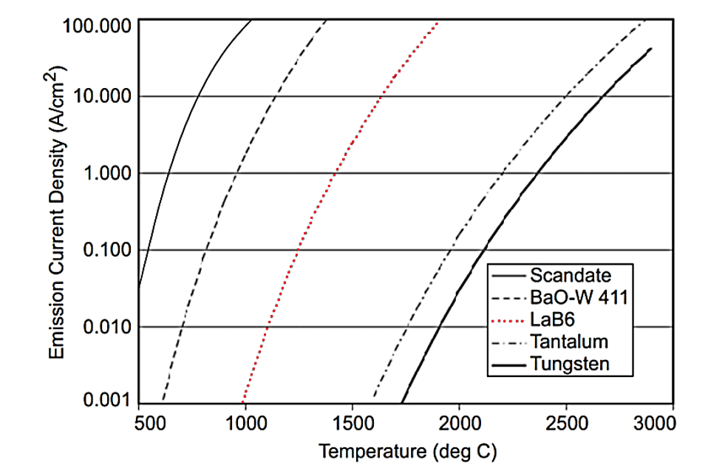
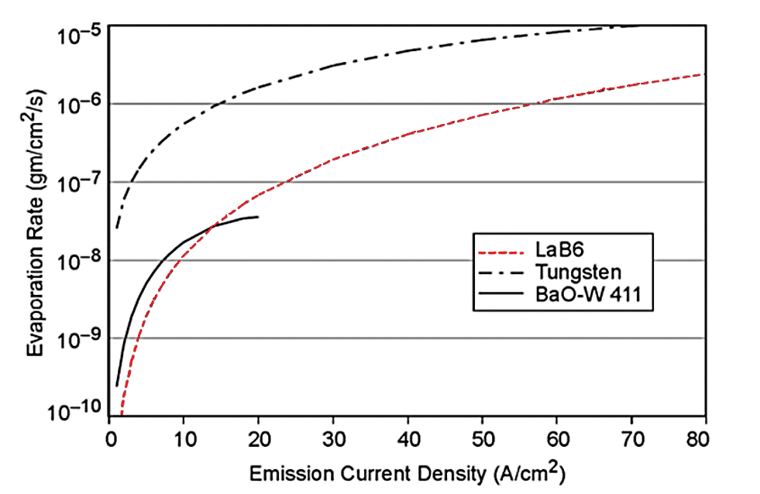
AGENDA
Cathode Selection
Figure 5: Evaporation Rate of Type-S 4:1:1 - dispenser cathodes, LaB6, and tungsten [6]
Figure 6: Emission current density versus temperature for various cathode materials [6]

Slide 19
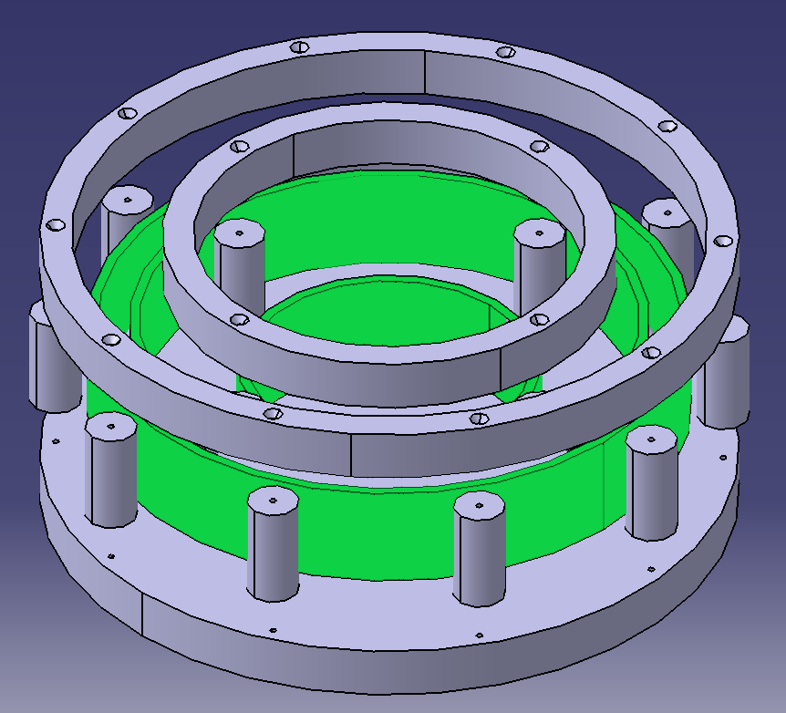
AGENDA
Insulator Selection
Alumina Silicate
  Easily machined in house
  Cheap and readily available online
  Important component in refractory ceramics and temperature insulators
  High temperature strength
  Low coefficient of thermal expansion
Dimensions
 | ID (in.) | OD (in.) | Height (in.)
Outer Channel | 2.75 | 2.85 | 0.50
Inner Channel | 2.36 | 2.46 | 0.50
Figure 7: Current ERAU Hall Thruster Model - Insulators

Slide 20
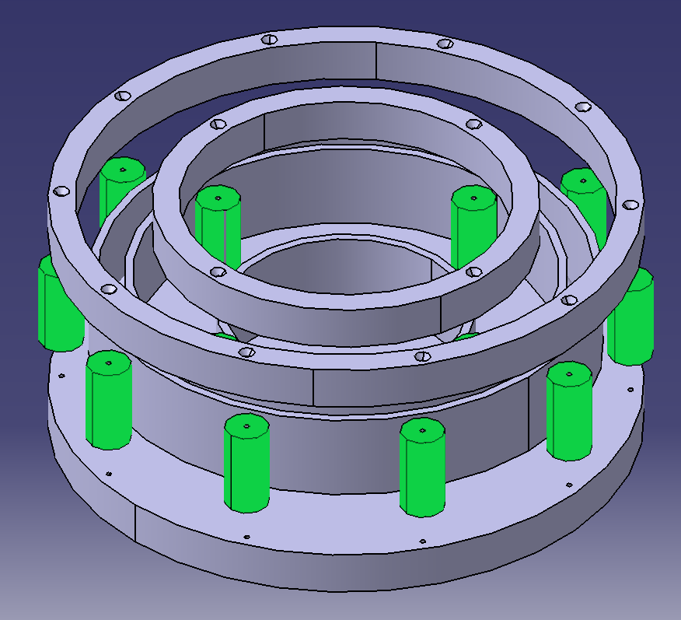
AGENDA
Magnetic Circuit Design
A36 Steel
  Low carbon: Easily machined in house
  Cheap and readily available online
  High electrical conductivity
Bobbin Assembly
  Hand wound high gauge wire around machined A36 cylinders
  4-inner and 10-outer bobbins total
Figure 8: Current ERAU Hall Thruster Model - Bobbins

Slide 21
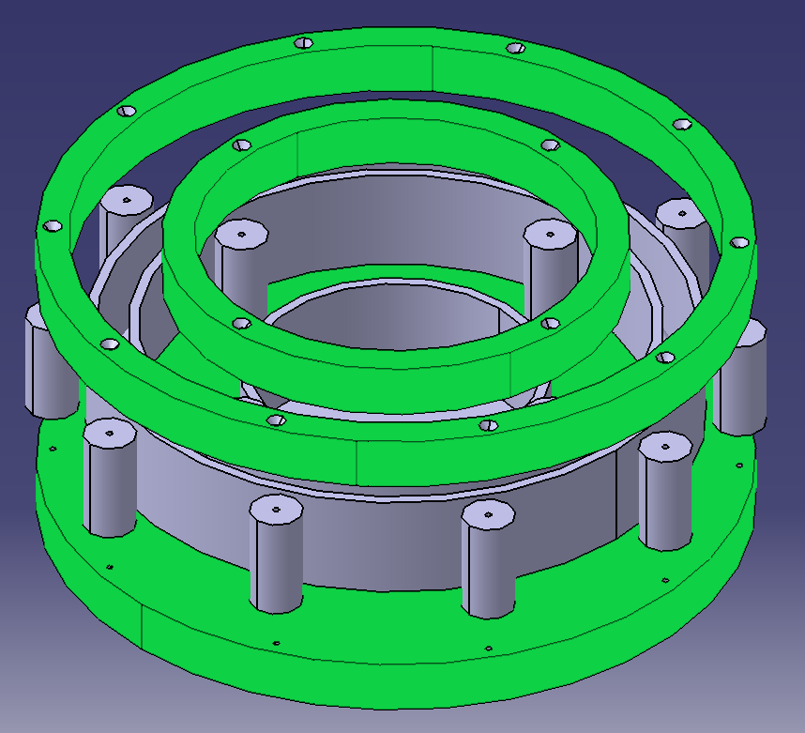
AGENDA
Magnetic Circuit Design
A36 Steel
  Low carbon: Easily machined in house
  Cheap and readily available online
  High electrical conductivity
Face Assemblies
  Water jet cut from a common thickness plate/bar
  Direct interface with bobbins and electrical power systems
Figure 9: Current ERAU Hall Thruster Model - Irons

Slide 22
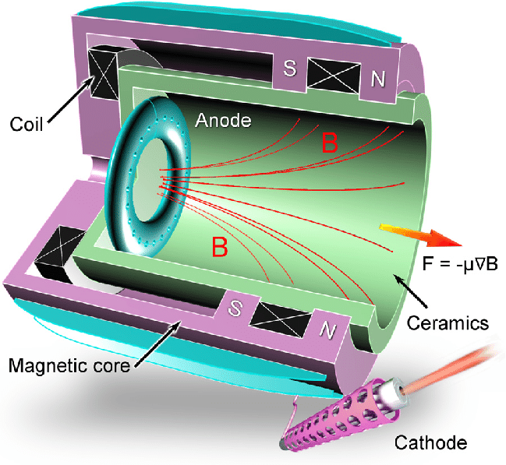
AGENDA
Anode Design
Stainless Steel
  Easily machined in house
  Cheap and readily available online
  Corrosion resistant
  Low coefficient of thermal expansion
Anode Manufacturing
  Seal one end of 1/8 in. OD tube (ID: 0.028 in.)
  Drill 10 evenly spaced 1/32 in. diameter holes
  Bend thin walled tube around a 2.475 in. mandrel
  Bend open end down and feed through hole in back iron plate
Figure 10: Hall Thruster Cut Away [7]
Notes:
https://www.researchgate.net/figure/Schematic-of-a-cylindrical-Hall-thruster-CHT-36-A-smaller-surfaceto-volume-ratio-in_fig8_323376145

Slide 23
Sources
“HALE,” HALE | SPACE TECHNOLOGIES RESEARCH INSTITUTEAvailable: https://uzay.tubitak.gov.tr/en/uydu-uzay/hale.
“Hall Effect Thrusters,” Beyond NERVAAvailable: https://beyondnerva.com/electric-propulsion/hall-effect-thrusters/.
“Beyond frontiers,” SESAvailable: https://www.ses.com/.
“Periodic Table – Royal Society of Chemistry,” Royal Society of Chemistry - Advancing excellence in the chemical sciencesAvailable: http://www.rsc.org/periodic-table/.
UCSB Science LineAvailable: http://scienceline.ucsb.edu/getkey.php?key=928.
Goebel, D. M., and Katz, I., Fundamentals of electric propulsion: ion and hall thrusters, Hoboken: John Wiley, 2008.
Levchenko, I., and , “Space micropropulsion systems for Cubesats and small satellites: From proximate targets to furthermost frontiers,” Applied Physics Review Available: .

